Slide 1

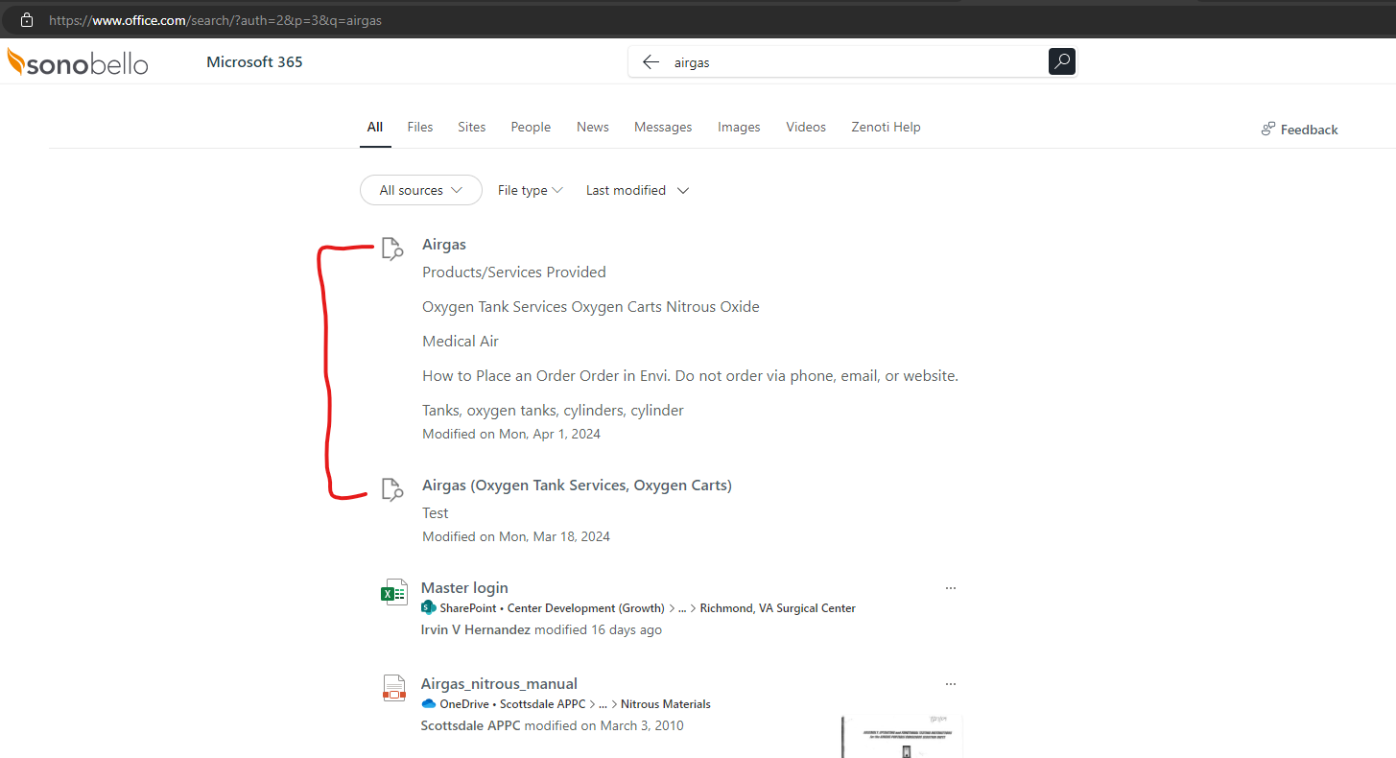
Sono Bello - M365 Custom Search Implementation
What We Did
Sono Bello Requirements - Sono Bello is using Fresh Service subscription to create, manage and refer Solution Articles (KB articles). Sono Bello is looking to extend Microsoft Search capabilities in M365 environment to crawl and index Fresh Service Solution Articles and show the search results on MS-Search search result page. Fresh Service may have different folders created to store solution articles and MS Search should show all solution articles matching search keyword entered in Search box. Sono Bello Users should pass authentication while browsing Solution articles in MS Search results.
Affirma Team Solution Approach - Affirma Team built out a C# Custom connector to set up a communication bridge between Sono Bello M365 environment with Fresh Service platform.
This Custom connector will be responsible for getting required information (solution article information) from Fresh Service external database and pass it to M365 Crawling database and showed in MSFT Search and SharePoint Search. The new custom connector is now capable of crawling and indexing ‘FreshService’ external data source (~204 Solution articles). MS Search experience has been updated recently to display search results directly from Fresh Service data source as attached.
The Results

